Slide 1
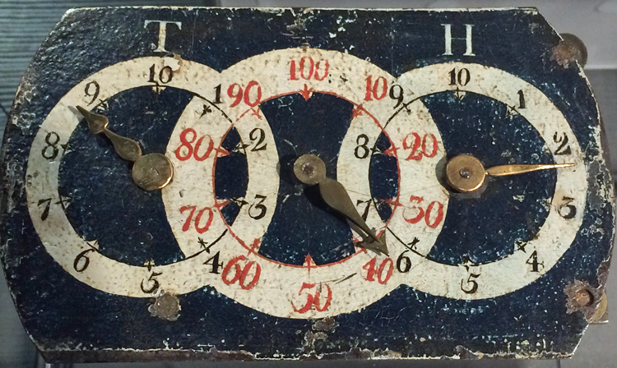
Royal Institution Primary Maths Masterclasses
Science on Stage:
Benjamin Franklin’s Odometer
rigb.org @Ri_Science
Image credits: Eric S Hintz
Insert image here
Notes:
Title slide, nice pictures to show what’s coming!

Slide 2
Benjamin Franklin’s Odometer
We are going to travel back in time to when Benjamin Franklin invented the odometer. What year was that?
1763
How many years ago is that?
257 years!
Can you list some of the things which are the same in 2020 as in 1763? And some which are different?

Slide 3
Benjamin Franklin’s Odometer
Where are we? (in our imagination)
America…but not as we know it!
Have you been to America or seen pictures of this country today?
In 1763 America is a colony: it “belongs” to European countries, and some of it (further west: the wild west!) hasn’t even discovered by Europeans yet.
The British Government is trying to rule the American colonies from London. Why might that be difficult?

Slide 4
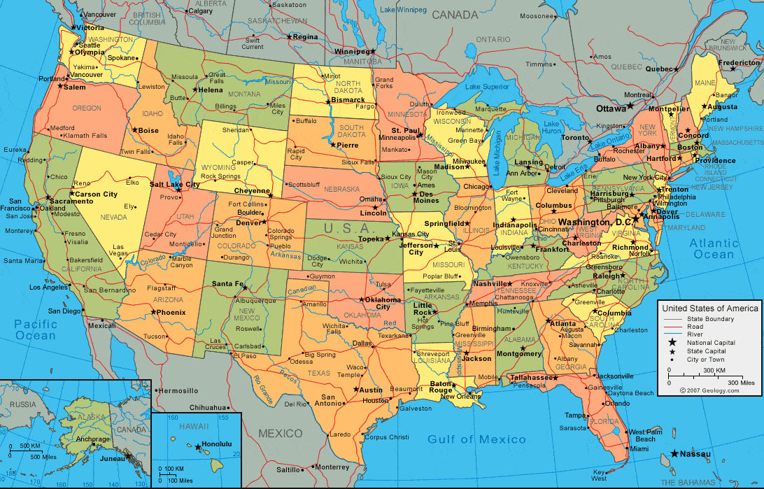
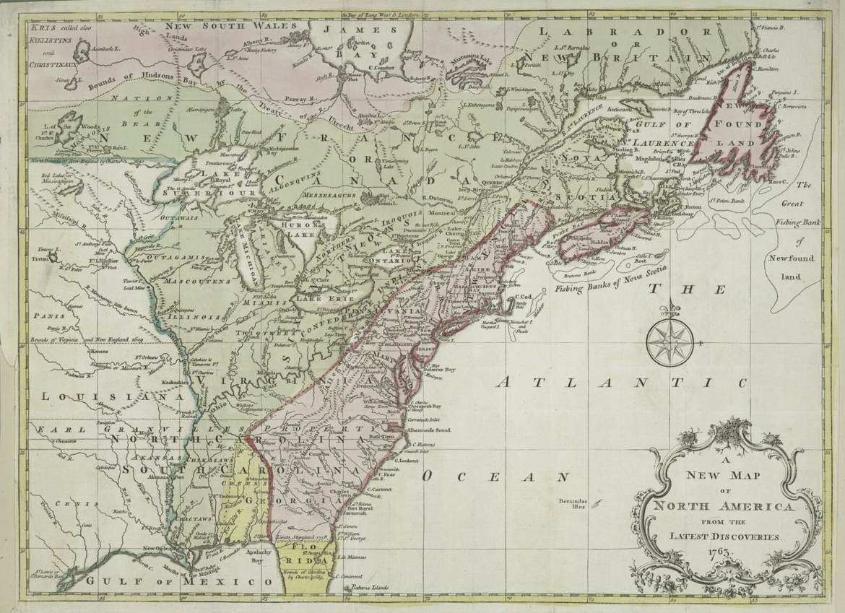
Benjamin Franklin’s America
Not only was communication difficult between America and England, but also within the colony. The pink area belongs to England. How do you think they communicated with each other?
Apparently boats were often the best way to send post.
Image credits: By New York Public Library, CC0, https://commons.wikimedia.org/w/index.php?curid=32049475

Slide 5
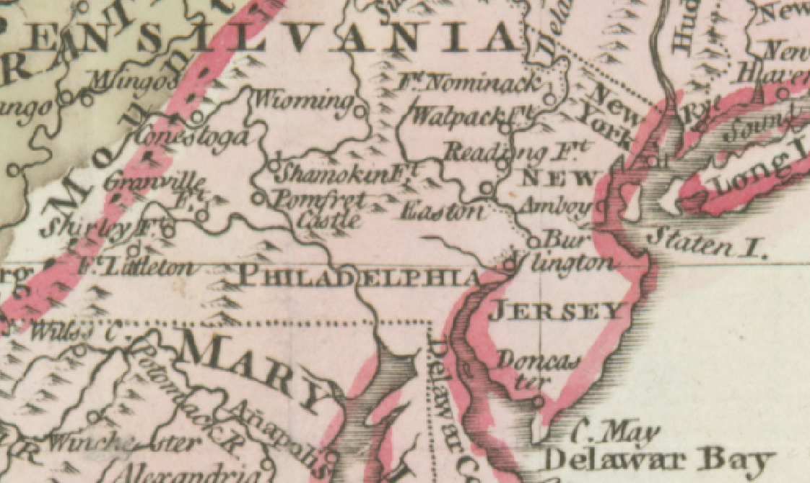
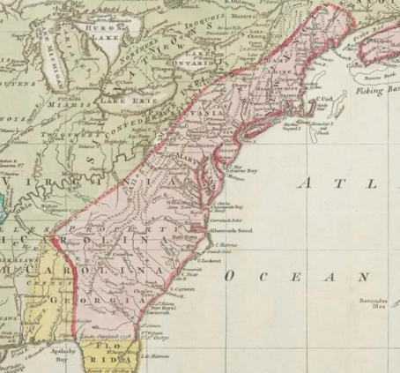
Benjamin Franklin’s Problem
Postal service in the United States was greatly influenced by Benjamin Franklin who was appointed Postmaster of Philadelphia in 1737, Joint Postmaster General of the colonies for the Crown in 1753, and Postmaster for the United Colonies in 1775.
Originally (in 1737) Franklin was in charge of the post in Philadelphia.
In 1753 he was put in charge of the whole of the British Colonies (all the pink area)
The postal service was:
Unreliable
Slow
Losing money
But Franklin was determined to change this!
Image credits: By New York Public Library, CC0, https://commons.wikimedia.org/w/index.php?curid=32049475

Slide 6
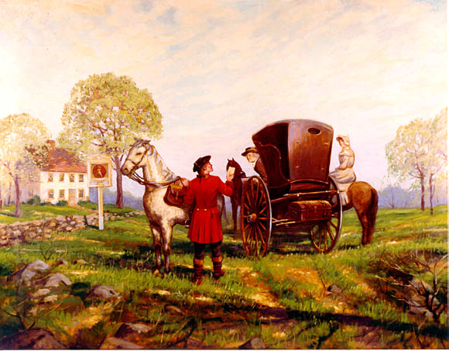
1763 Benjamin Franklin’s tour
1763 - The Boston Post Road
While traveling to inspect post offices from New Jersey to New England, Franklin used an odometer to measure the distance between postal stations. The painting shows him on a post office tour in a one-horse chaise, accompanied by his daughter on horseback, while a post rider delivers an urgent message.
Image credits: Carl Rakeman via USDoT

Slide 7
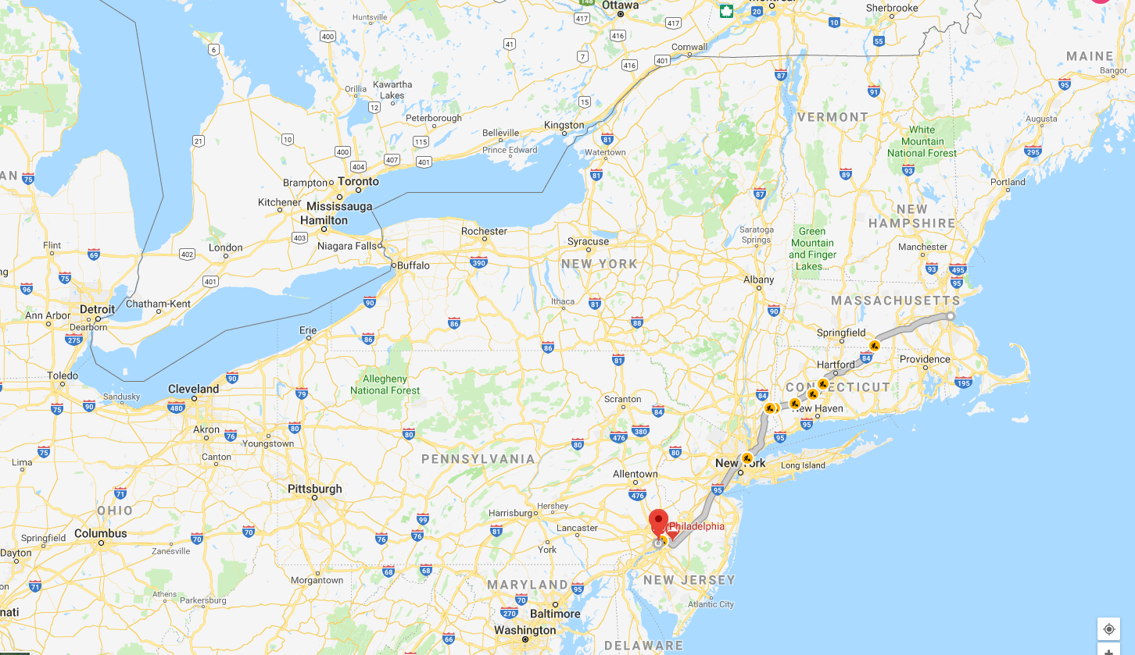
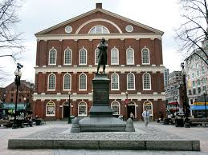
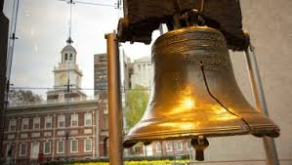
Benjamin Franklin’s Calculation
Benjamin Franklin wanted to know how far he had travelled from Boston to Philadelphia
Boston
Philadelphia
Image credits: Robert Feke via Wikimedia Commons

Slide 8
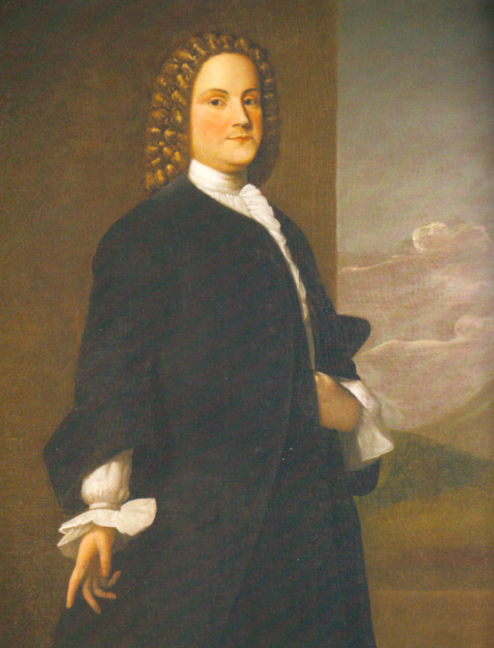
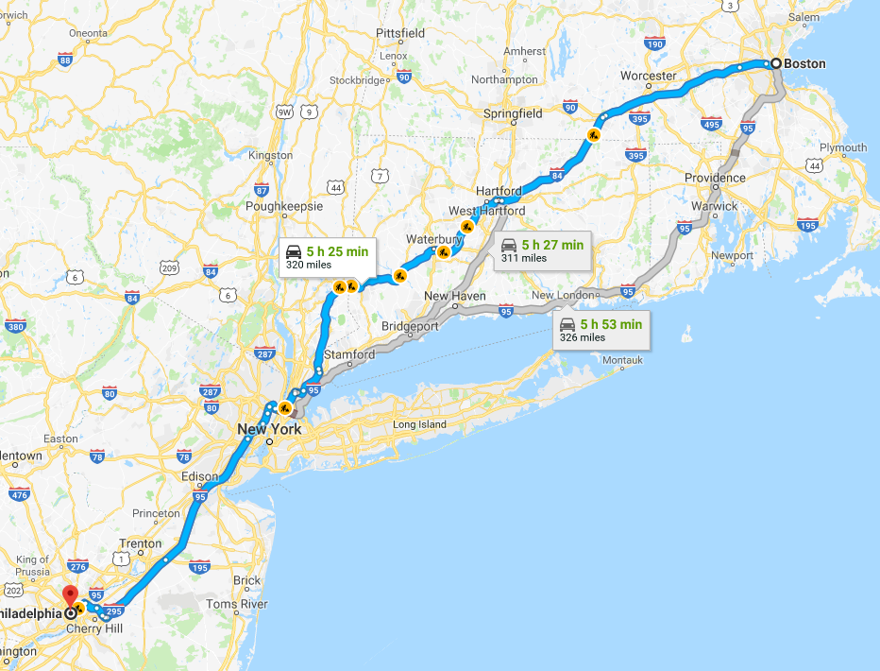
Benjamin Franklin’s Calculation
The answer was…
320 miles!
On his whole 5 month journey he travelled all over the British colonies, covering thousands of miles!
Benjamin Franklin in 1748
Image credits: Robert Feke via Wikimedia Commons
Notes:
Franklin served as Philadelphia’s postmaster for many years and was later promoted to deputy postmaster-general for all of Britain’s American colonies in 1753.

Slide 9
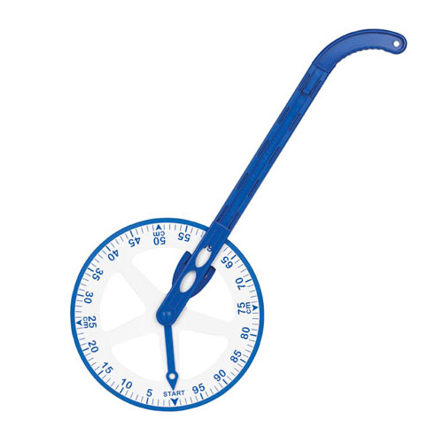
Benjamin Franklin’s Calculation
When scientists want to solve a big problem they often start by solving a related smaller problem.
So instead of measuring the distance from Boston to Philadelphia, I am going to think about measuring the distance around this room.
How could I do this? Can you think of any suggestions? How could I measure a distance which is not it a straight line?
A trundle wheel!
Image credits: EAI Education website
Notes:
Franklin served as Philadelphia’s postmaster for many years and was later promoted to deputy postmaster-general for all of Britain’s American colonies in 1753.

Slide 10
Benjamin Franklin’s Calculation
Franklin measured the circumference (perimeter of a circle) of his carriage wheel, and discovered that when his wheel turned a full circle he had gone forward about 4 metres, as it was 402cm around the wheel.
This means each revolution (full turn) is about 1/400th of a mile.
Franklin designed a series of cogs which registered 1 mile travelled after 400 revolutions of the carriage wheel.
Image credits: http://www.robotc.net/wikiarchive/Tutorials/Arduino_Projects/Mobile_Robotics/BoeBot/Using_encoders_to_drive_some_distance

Slide 11
What number do you think these dials are showing?
8,238
revolutions
TH: Between 8 and 9 thousand?
H: Between 2 and 3 hundred?
T: Between 30 and 40?
About 38?
= 20.6 miles
8238÷400

Slide 12
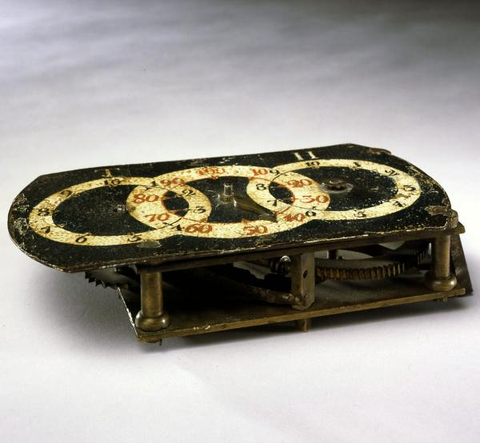
Can you see the geared wheels?
How do gears work?
Follow the link to find out more:
https://www.youtube.com/watch?v=UOhFri6FPrs
Image credits: Peter Harholdt, 2004

Slide 13
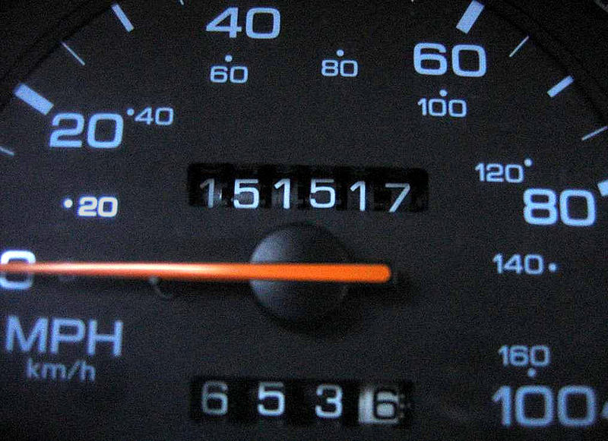
What is this?
A modern odometer from a car!
Image credits: Skippy 13 via Wikimedia commons

Slide 14
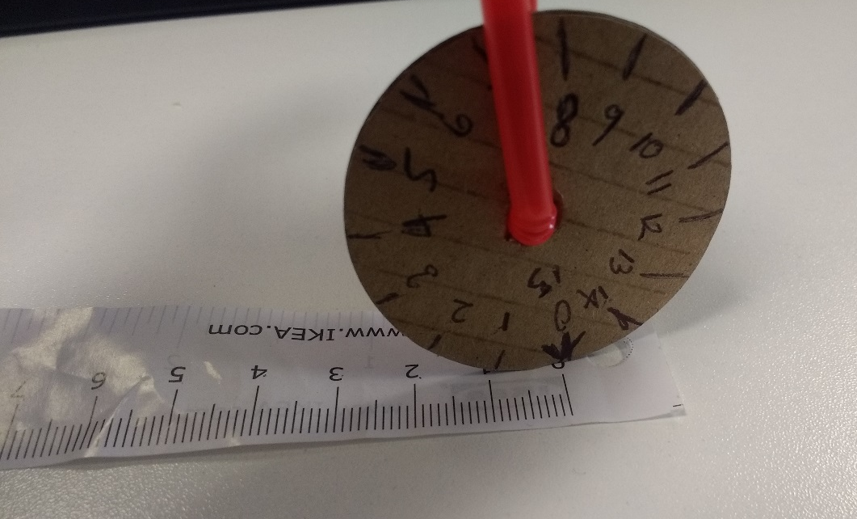
Make your own “odometer”
You will need: a small disc of cardboard, a straw, a tape measure and a pencil
Measure (in cm) the circumference of your cardboard disc using the tape measure.(Roll your disc along the tape, marking off the cm as the disc hits the markers.
Put an arrow at “0”
Mark off cm around the circumference using your pencil, and number (from 0), clockwise.

Slide 15
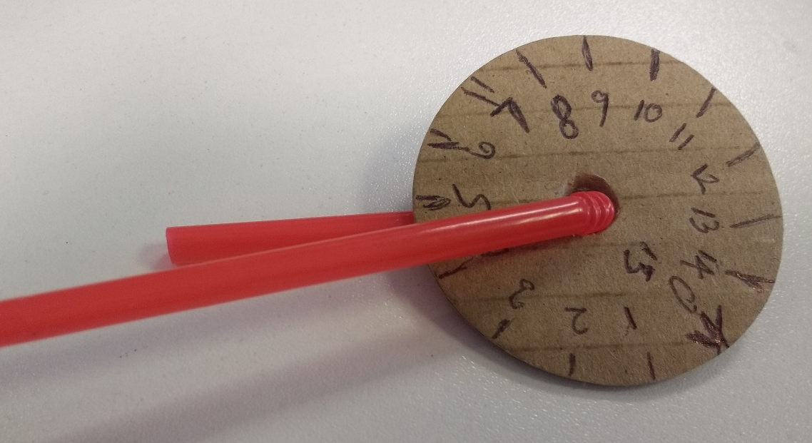
Make your own “odometer”
Thread the straw through the disc and bend the straw back.

Slide 16
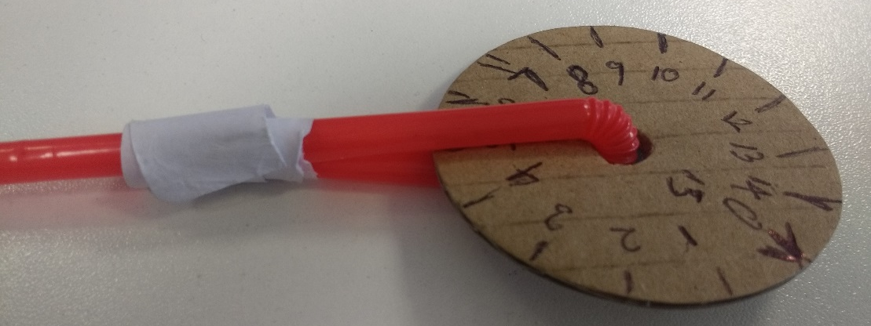
Make your own “odometer”
Secure the bent back straw with tape, making a handle (Keep the tape away from the disc). Make sure the wheel can rotate smoothly. You may need to leave a gap between the two bits of the straw when you stick the tape down.

Slide 17
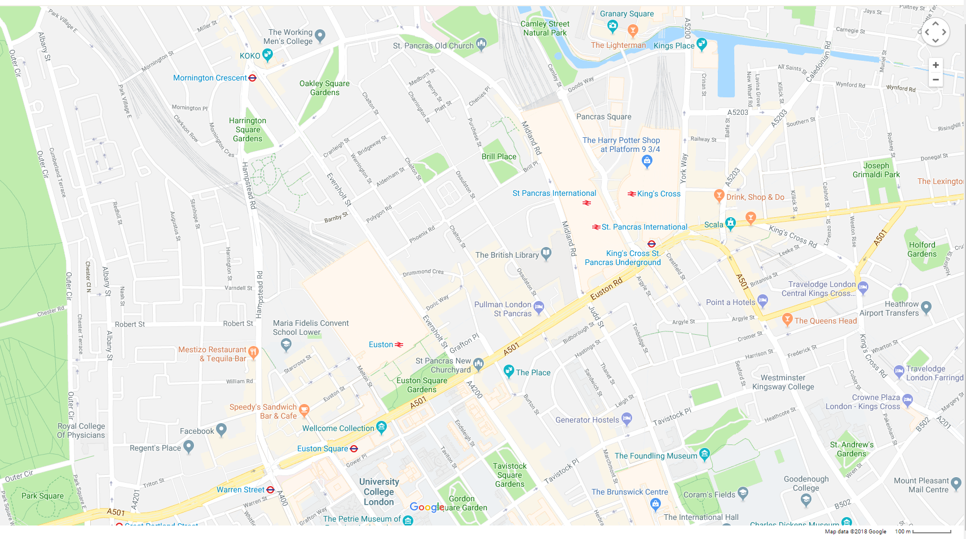
Use your own “odometer” on a map
Make sure your wheel rotates freely
Set your mini odometer with zero at the bottom and place it on the end of a road. Wheel the odometer to the end of the road and measure how far it is in centimetres.
Use the map’s scale to convert this to meters or kilometres

Slide 18
Royal Institution Primary Maths Masterclasses
Thank you!

